Slide 1
DAY 9 PPT
SEARCHING,MACROS

Slide 2
JUMP SEARCH
Jump search technique also works for ordered lists. It creates a block and tries to find the element in that block.
If the item is not in the block, it shifts the entire block. The block size is based on the size of the list.
If the size of the list is n then block size will be √n. After finding a correct block it finds the item using a linear search technique.
The jump search lies between linear search and binary search according to its performance.
Let’s consider the following array: (0, 1, 1, 2, 3, 5, 8, 13, 21, 34, 55, 89, 144, 233, 377, 610). The length of the array is 16. The Jump search will find the value of 55 with the following steps assuming that the block size to be jumped is 4 STEP 1: Jump from index 0 to index 4; STEP 2: Jump from index 4 to index 8; STEP 3: Jump from index 8 to index 12; STEP 4: Since the element at index 12 is greater than 55, we will jump back a step to come to index 8. STEP 5: Perform a linear search from index 8 to get the element 55.

Slide 3
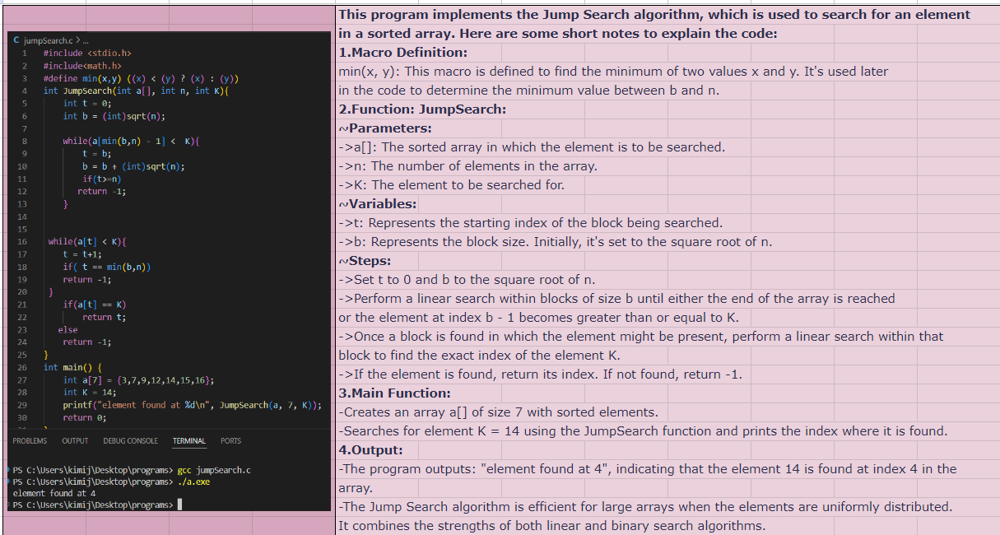
JUMP SEARCH PROGRAM

Slide 4
LINEAR SEARCH
Linear search is a sequential searching algorithm where we start from one end and check every element of the list until the desired element is found. It is the simplest searching algorithm.
In worst-case scenarios, the Linear Search takes linear time and performs at most n comparisons, where n is the list's length.
If each element has an equal chance of being searched, Linear Search has an average case of n+1/2 comparisons, but the average case can be influenced if the search probability for each element differs. Linear Search is rarely feasible as other search algorithms and schemes (such as the binary search algorithm and hash tables) that provide significantly faster search operation for all lists.
The following are the steps involved in implementing Linear Search:
We must first use a for loop to traverse the array elements.
In the process of searching an element in a list of elements, we should start by comparing the search element with the current list of elements in each iteration of the loop, and if the elements match, return the index of the relevant array element.
If the element we're looking for doesn't match, move on to the next one.
Return -1, if there is no match or the search element is not found in the given array.

Slide 5
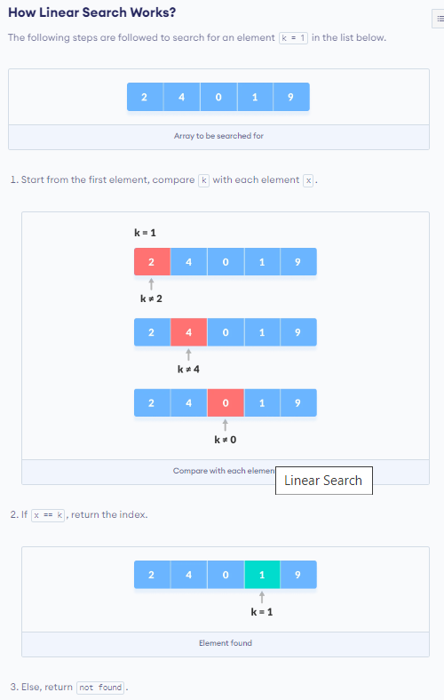
LINEAR SEARCH WORKING

Slide 6
MACROS
In C, a macro is a piece of code in a program that is replaced by the value of the macro. Macro is defined by #define directive. Whenever a macro name is encountered by the compiler, it replaces the name with the definition of the macro. Macro definitions need not be terminated by a semi-colon(;).

Slide 7
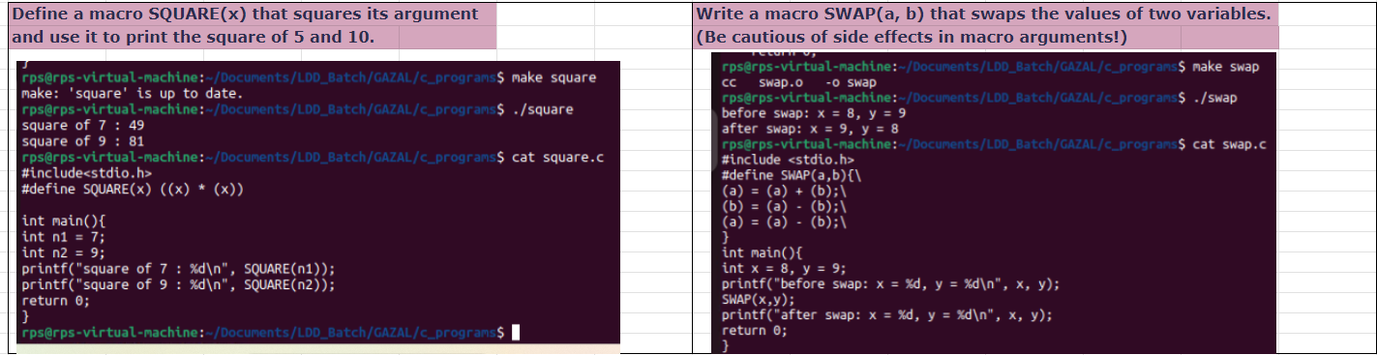
PROGRAM OF SWAP AND SQUARE USING MACROS

